Slide 1


Titolo presentazione sottotitolo
E-health Methods and Applications [I.C.]: Project Presentation
Stardust Stroopers: Test your sharpness in space
Milano, XX mese 20XX
Balentovic Lana
Gallo Pietro Marco
Gholami Vajihe
La Camera Alessandro Pietro
Zattoni Elena
Zovko Marija
December 21st, 2022

Slide 2
Introduction: ADHD and the Stroop test
“Attention-deficit/hyperactivity disorder (ADHD) is marked by an ongoing pattern of inattention and/or hyperactivity-impulsivity that interferes with functioning or development.” [1]
Major symptoms include:
Inattention
Hyperactivity
Impulsivity
“The Visual Stroop Test is designed to assess cognitive flexibility and attention span by examining a patient’s ability to separate word and color naming stimuli through the use of three separate subtests.” [2]
A stimulus is presented that consists of two dimensions:
same response (congruent trials)
conflicting response (incongruent trials)

Slide 3

Aim of the project
Main critical issues of the ADHD treatment of choice:
low adherence to medication [3]
psychotherapies are not usually implemented in health systems [4]
lack of motivation and engagement in ADHD patients [5]
Video game-based therapeutic interventions benefits:
improve of attention, effort and motivation [6]
generally high engagement rates with videogames [7]
Development of a game which implements the Stroop effect without presence of words, in order to overcome difficulties related to reading disorders often affecting ADHD patients.

Slide 4
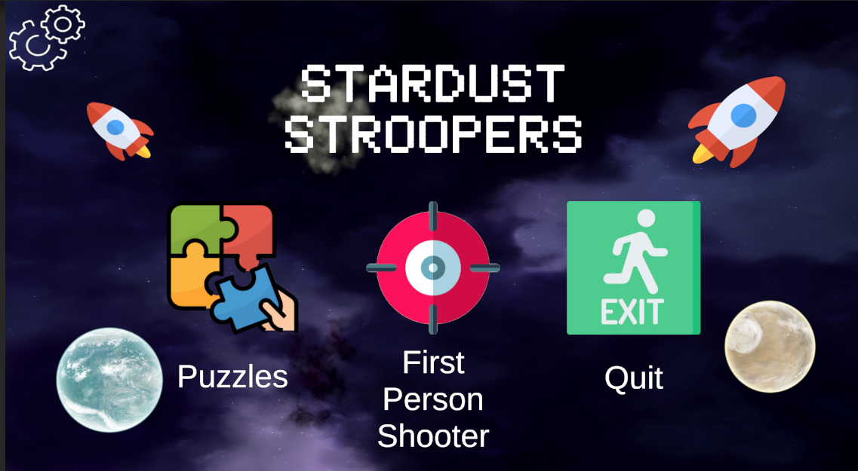
Game structure
“Stardust Stroopers” is developed in the Unity framework.
Within the game the following can be found:
A main menu containing:
4 minigames of two different types:
Three puzzles;
One First Person Shooter.
Settings Button;
Exit Button.
In each puzzle mini-game there is a “home screen” button.

Slide 5
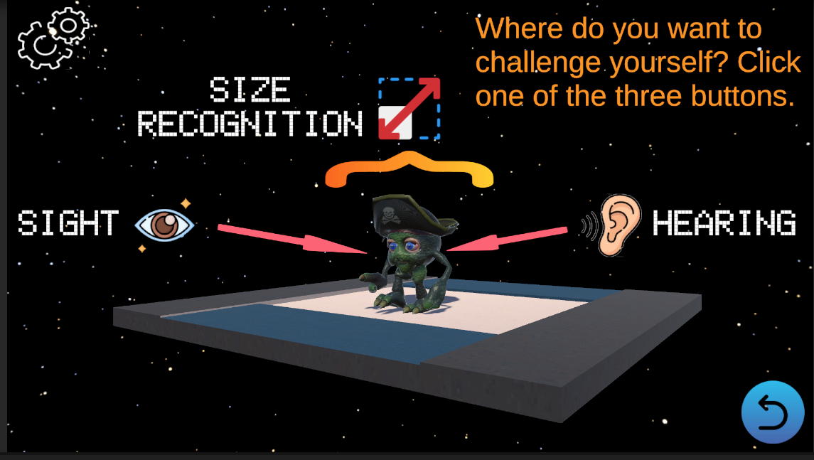
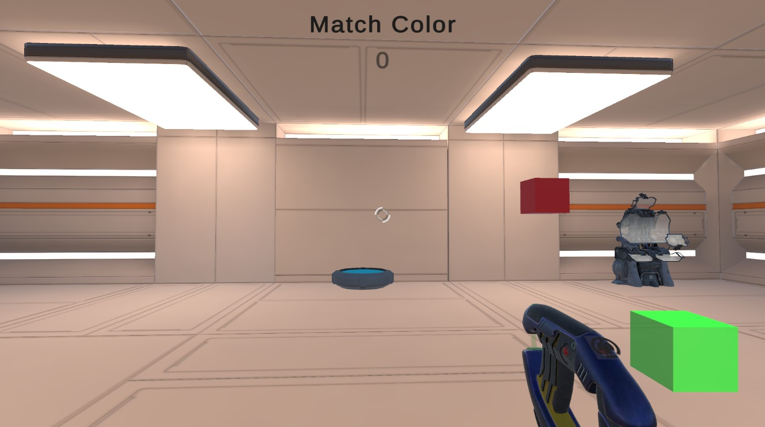
Game structure
Each minigame proposes a different variant of Stroop test, which doesn’t involve the classical reading of words and targets one of these four specific skills:
hearing,
size recognition,
character pattern recognition (sight),
color-shape recognition.

Slide 6
Where and by whom can the game be used?
The game is addressed to:
children and pre-adolescents within the age range of 9-12; [10]
but it is not exclusively for this age group. [9]
“Stardust Stroopers” can be played:
Whenever a child wants;
Without necessity of adult supervision;
Utilized by teachers in classrooms settings

Slide 7
From functional to technical requirements
Functional requirement | Technical requirement
Analyze what Stroop test variant statistically generates a greater stimulus interference | Keep record of scores and response times separately between different minigames and between levels within the same minigame
Easily playable | Create simple tutorials thoroughly explaining the functioning of each level

Slide 8
“Have I heard well?”
Implementation of an auditory Stroop test in three variants:
Level 1: voice pitch as incongruent stimulus;
Level 2: sight as incongruent stimulus with respect to what is heard;
Level 3: hearing as incongruent stimulus with respect to what is seen.
It takes inspiration from an exercise of the test delivered in [9];
Congruent and incongruent stimuli are presented together;
Type of minigame: puzzler interactive game.

Slide 9
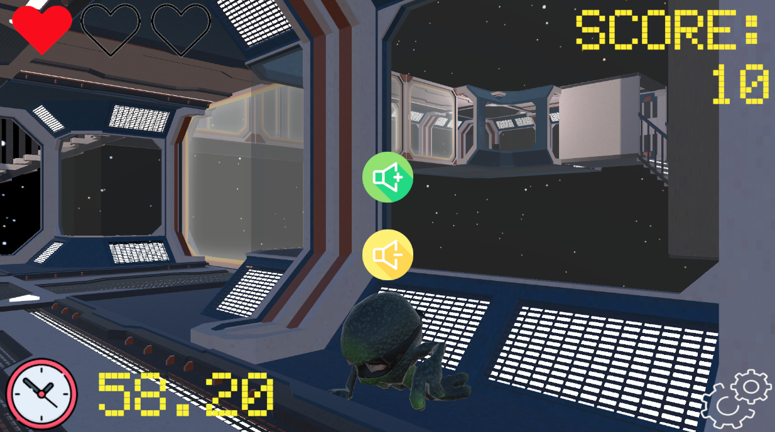
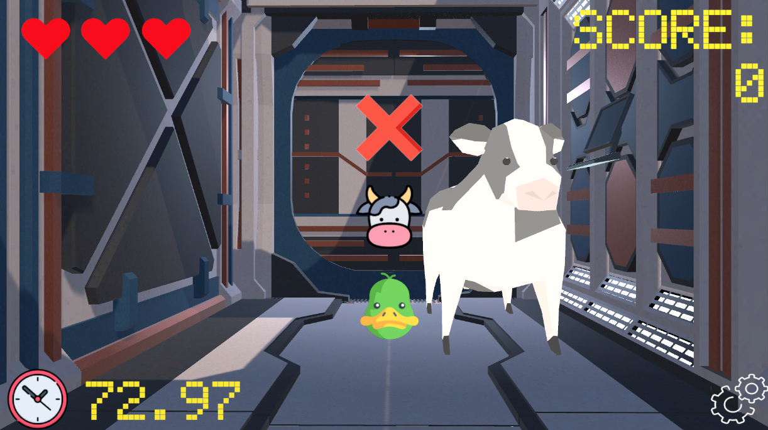
“Have I heard well?”: Setup
Setup of level 1
Setup of levels 2 and 3
Alien prefab playing the recorded clip of the word “high” or “low” when the player gets close to it
Pitch button to indicate the pitch of the audio clip
Animal button to indicate to whom the corresponding feature belongs:
The call being made (level 2);
The prefab in front of the player (level 3)
Animal prefab playing an audio clip of its call or of another animal’s
Number of remaining mistakes allowed

Slide 10
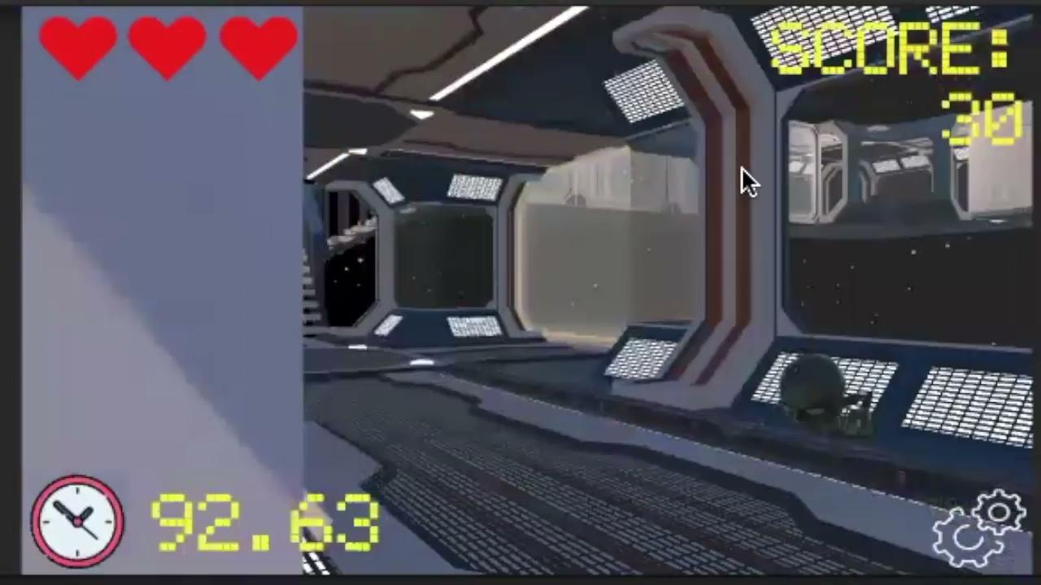
“Have I heard well?”: Level 1 Demo

Slide 11
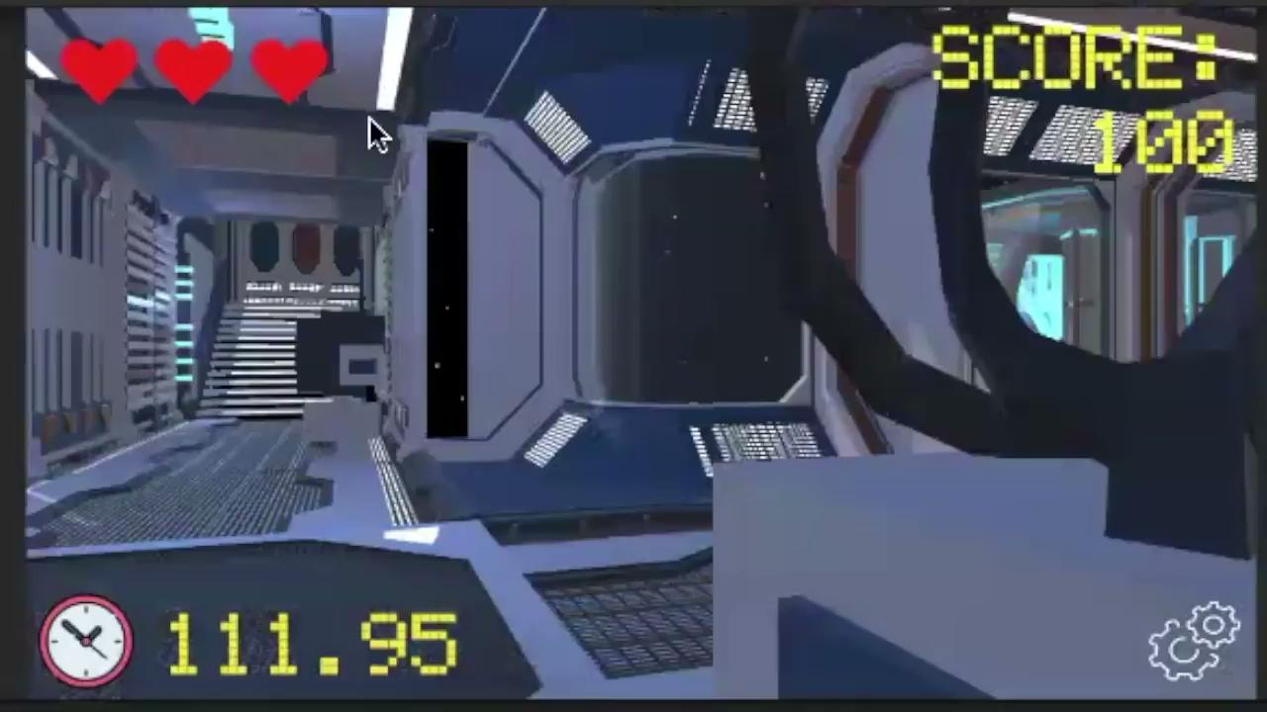
“Have I heard well?”: Level 2 Demo

Slide 12
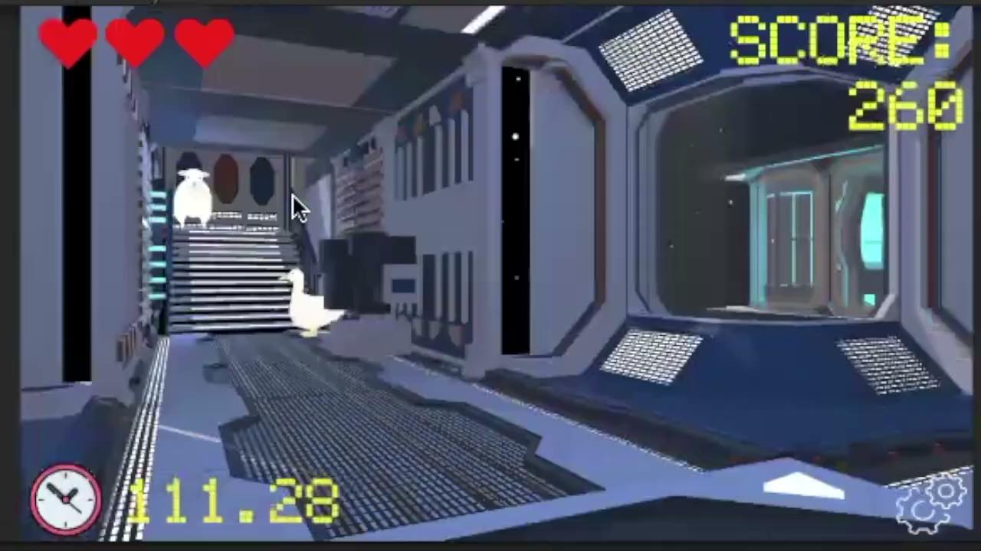
“Have I heard well?”: Level 3 Demo

Slide 13
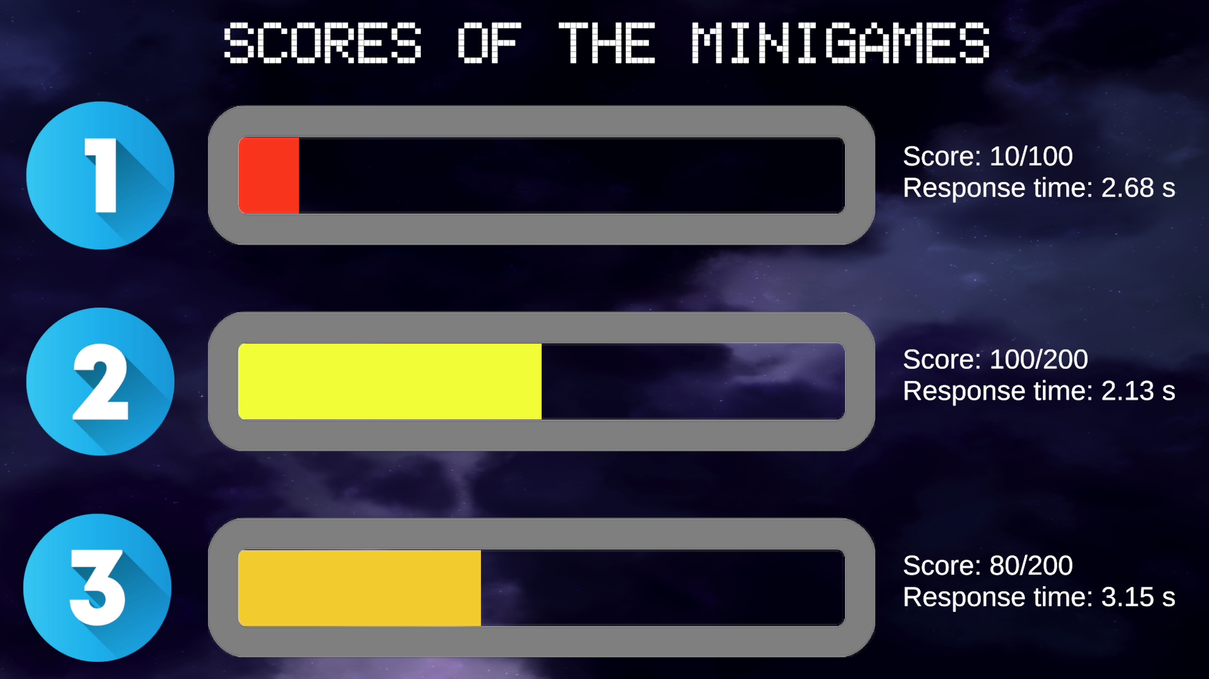
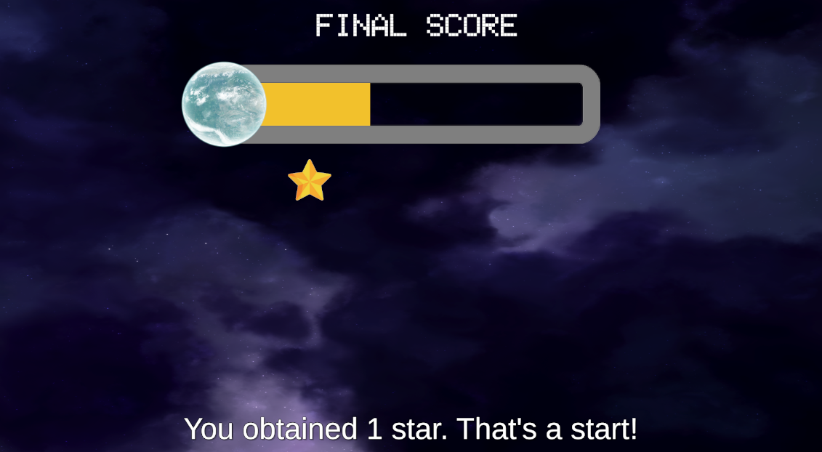
“Have I heard well?”: Scoring System
Separate scores of each level
Score: [achieved score] / [max achievable score]
Response time: average time spent when deciding for an answer in each level
Score assignment:
Level 1: +10 points per correct answer;
Levels 2 and 3: +20 points per correct answer.
Cumulative final score of the whole minigame
A star is assigned per hundred points obtained

Slide 14
“What is the correct letter?”
Implementation of a Navon test as a means of verifying the ADHD user's results after taking mini-games based on the Stroop test [8]
The mini-game focuses on the user's ability to recognize letters in a limited amount of time and it is structured in two levels:
congruent, in which large and small letters are equal
incongruent, in which large and small letters are different
The score system is based on performing the most answers correctly in the shortest possible time

Slide 15
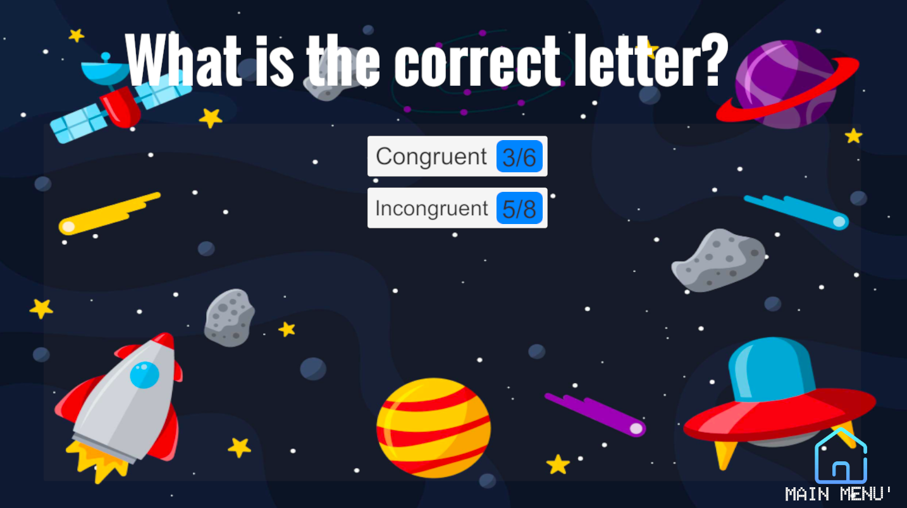
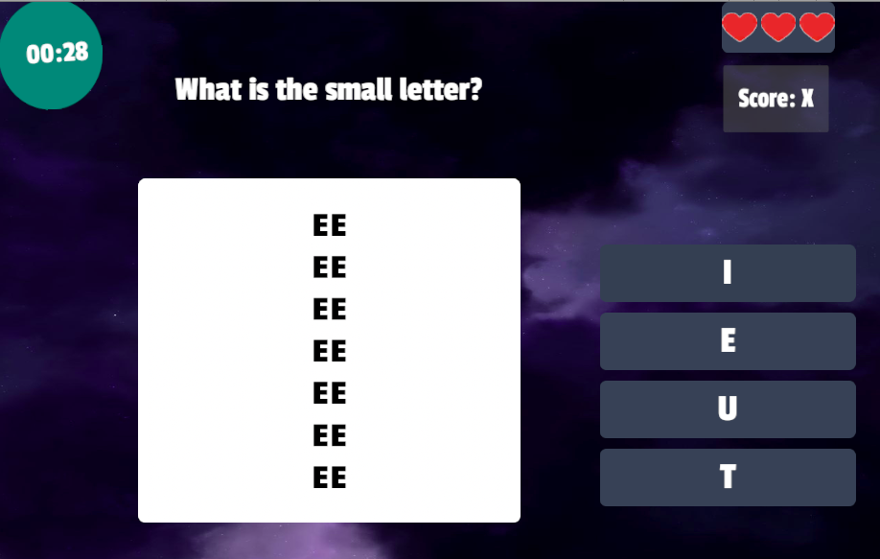
“What is the correct letter?”
Home Page
Number of questions completed in the ”Congruent level “
Timer
Mini-game Page
Scores and lives
Main Menù button
Answer button
QuizData Scriptable prefabs which contains the question and the image to be observed
Number of questions completed in the ”Incongruent level “

Slide 16

“What is the correct letter?” : Congruent level demo

Slide 17
“What is the correct letter?” : Incongruent level demo

Slide 18
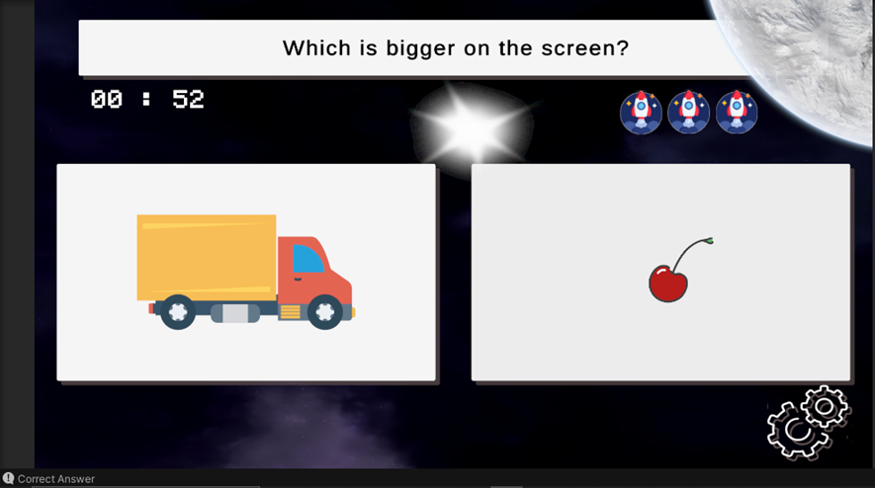
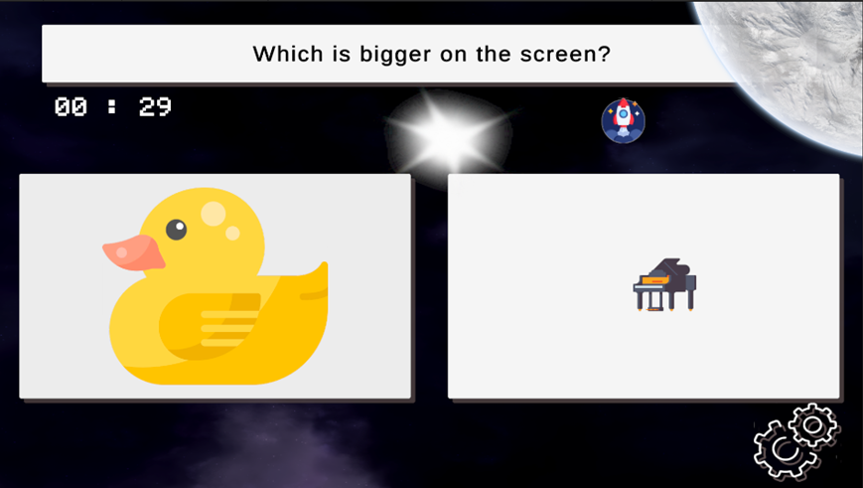
“The Little Big Things”: Game Play
Congruent vs. Incongruent
Timer
Remaining Lives
Settings Button
Possible Answers

Slide 19
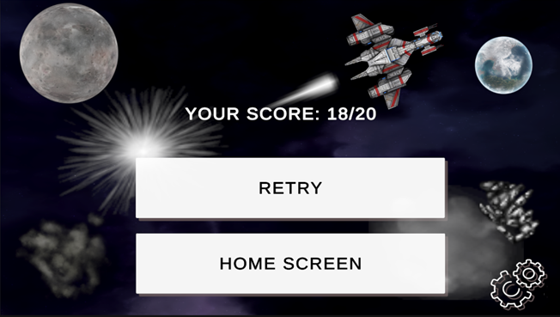
“The Little Big Things”: Game Over
Score Board
Try Again
Return to the Main Menu

Slide 20
“The Little Big Things”: Demo

Slide 21
“See you, space explorer”: Setup
Projectile property to match with targets
Score: +10 for each target eliminated
- 5 when target projectile mismatch
Target,
spawning one at a time
First person shooter type game
4 Levels
Minimalistic in-game HUD to show the projectile equipped

Slide 22
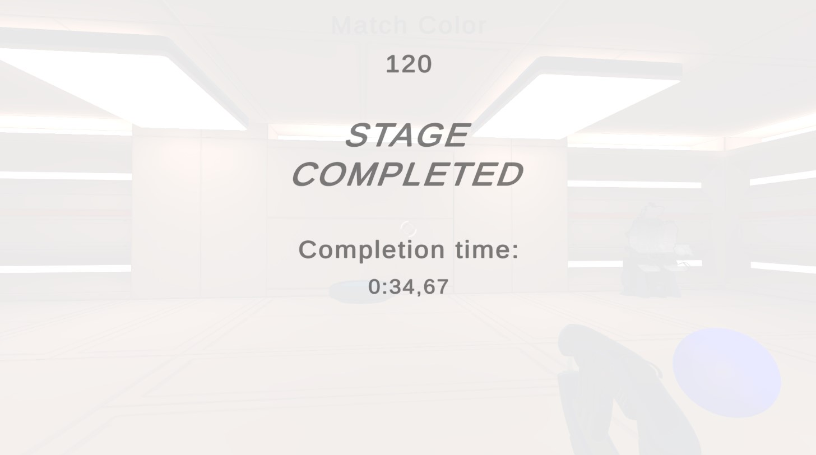
“See you, space explorer”: Stage completed screen
Total score
Time spent to complete the level

Slide 23
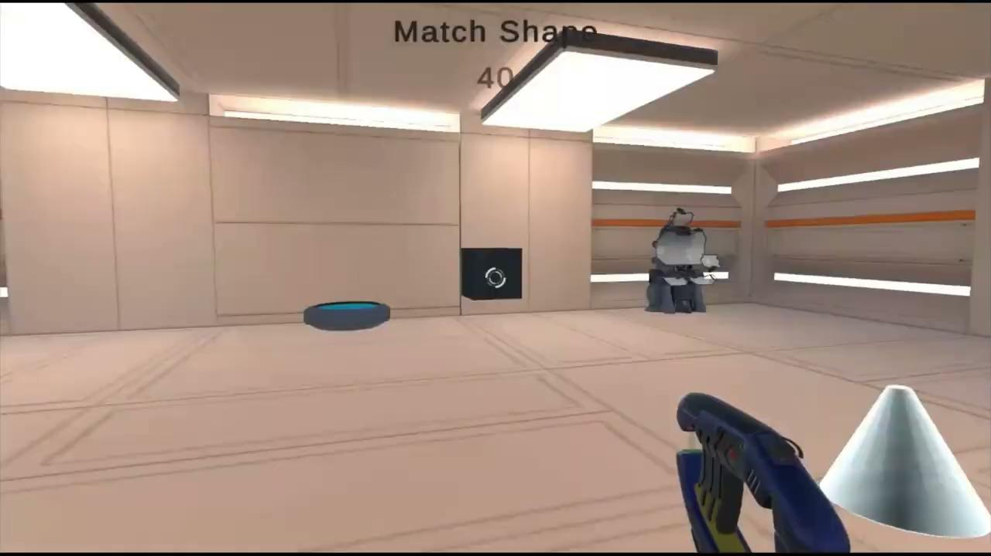
“See you, space explorer”: Stage 1 demo
Neutral stimuli:
Same shape and no color

Slide 24
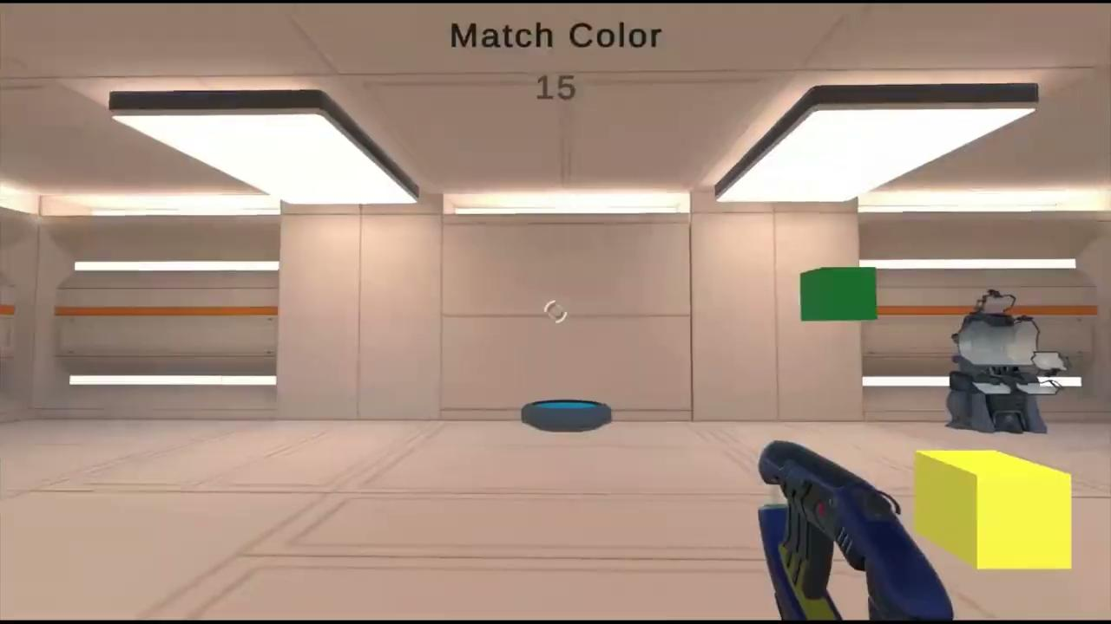
“See you, space explorer”: Stage 2 demo
Congruent stimuli:
Same color and only cubic shapes

Slide 25
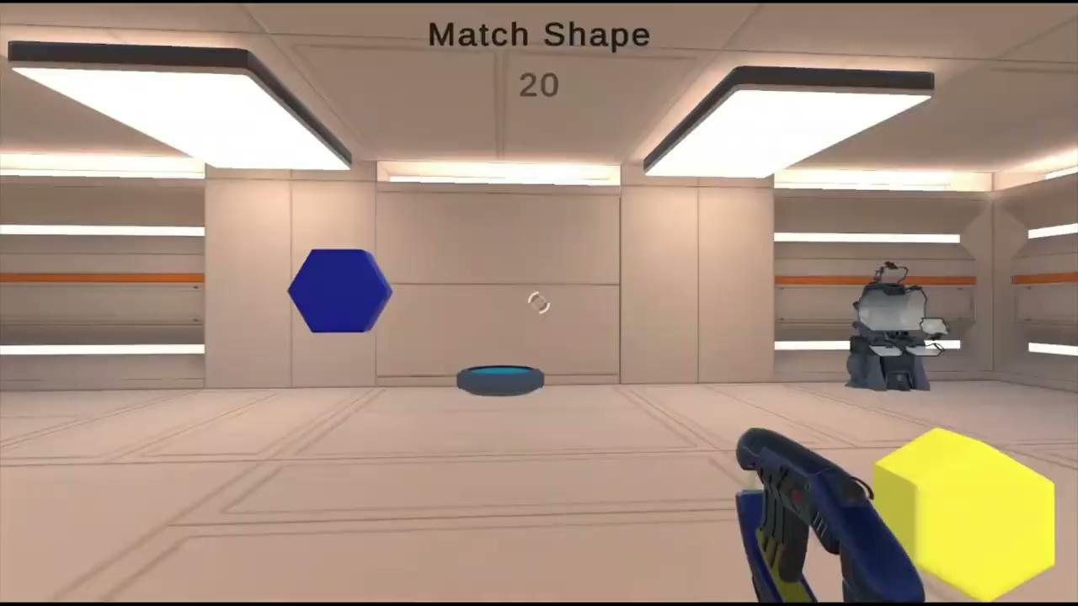
“See you, space explorer”: Stage 3 demo
Incongruent stimuli:
Same shape and different colors between targets and projectiles

Slide 26
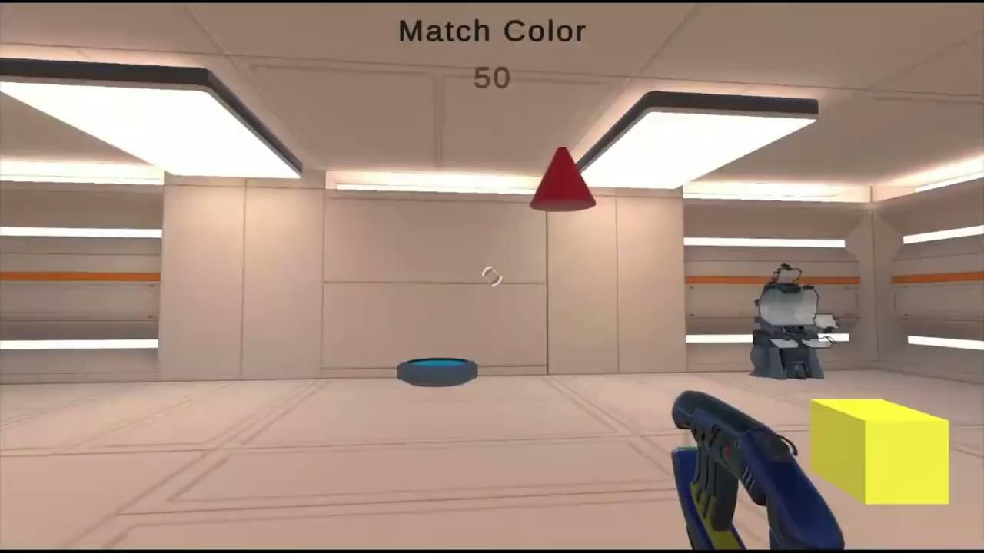
“See you, space explorer”: Stage 4 demo
Incongruent stimuli:
Same color and different shapes between targets and projectiles

Slide 27
Future improvements
Storage of the important data (e.g. score) using XML (extensible markup language)
A document encoding method
Designed to be both machine and human readable
Saving an entire data list instead of a single value (use of Player Prefs) [11]

Slide 28
Bibliography
[1] https://www.nimh.nih.gov/health/topics/attention-deficit-hyperactivity-disorder-adhd (Last Reviewed: September 2022)
[2] Head and FaceE”David J. Magee PhD, BPT, CM, in Orthopedic Physical Assessment, 2021. https://www.sciencedirect.com/topics/medicine-and-dentistry/stroop-test
[3] Marcus SC, Durkin M. Stimulant adherence and academic performance in urban youth with attention-deficit/hyperactivity disorder. J Am Acad Child Adolesc Psychiatry 2011 May;50(5):480-489. [doi: 10.1016/j.jaac.2011.02.007]
[4] Pottegård A, Bjerregaard BK, Kortegaard LS, Zoëga H. Early discontinuation of attention-deficit/hyperactivity disorder drug treatment: a Danish nationwide drug utilization study. Basic Clin Pharmacol Toxicol 2015 Apr 07;116(4):349-353. [doi: 10.1111/bcpt.12325]
[5] Barkley R. Attention-deficit hyperactivity disorder: a handbook for diagnosis and treatment. Fourth Edition. New York, NY: Guilford Press; 2018.
[6] Granic I, Lobel A, Engels RCME. The benefits of playing video games. Am Psychol 2014 Jan;69(1):66-78. [doi:10.1037/a0034857]
[7] Peñuelas-Calvo I, Jiang-Lin LK, Girela-Serrano B, Delgado-Gomez D, Navarro-Jimenez R, Baca-Garcia E, et al. Video games for the assessment and treatment of attention-deficit/hyperactivity disorder: a systematic review. Eur Child Adolesc Psychiatry 2022 Jan 18;31(1):5-20. [doi: 10.1007/s00787-020-01557-w]
[8] Hine K, Itoh Y (2018) Warm-up cognitive activity enhances inhibitory function. PLoS ONE 13(10): e0206605. https://doi.org/10.1371/journal.pone.0206605

Slide 29
Bibliography
[9] Kestens K, Degeest S, Miatton M, Keppler H. An Auditory Stroop Test to Implement in Cognitive Hearing Sciences: Development and Normative Data. Int J Psychol Res (Medellin). 2021 Jul-Dec;14(2):37-51. doi: 10.21500/20112084.5118. PMID: 35096355; PMCID: PMC8794330. Available: https://pubmed.ncbi.nlm.nih.gov/35096355/
[10] Schwartz K, Verhaeghen P. ADHD and Stroop interference from age 9 to age 41 years: a meta-analysis of developmental effects. Psychol Med. 2008 Nov;38(11):1607-16. doi: 10.1017/S003329170700267X. Epub 2008 Jan 29. PMID: 18226285. Available: https://pubmed.ncbi.nlm.nih.gov/18226285/
[11] French J. How to keep score in Unity (with loading and saving). Gamedevbegineer. 2021 Jul. Available: https://gamedevbeginner.com/how-to-keep-score-in-unity-with-loading-and-saving/#save_high_score

